Slide 1
Student Result Management System Using Node JS

Slide 2
Project Presentation
Submitted by:
1.Rajshri Thete
2. Sanchita Bhaktha
3. Manali Patil
4. Priti Yadav
Submitted To:
Mr.Anuj Kumar

Slide 3
Contents
Introduction
Requirement
Features
Entity Relation Model
Decision Tree
Screenshots.
Conclusion

Slide 4
Introduction
About Student Result Management System
"StudentResult Management System is a solution tool that is designed to track, maintain and manage all the data generated by a School, including the grades of a student, their attendance, their interpersonal activities records, etc.,"

Slide 5
Introduction
About Node JS
Node.js is an open-source, cross-platform, back-end JavaScript runtime environment that runs on the V8 engine and executes JavaScript code outside a web browser.

Slide 6
Requirement
Technology Used:
Front End: HTML, CSS, JavaScript, Handlebars.
Language: Node JS
Back End: MySQL

Slide 7
Requirement
Software configuration:
Operating system: Windows or Linux
Software: Visual studio code
Database: MySQL Database Service
Server: Apache HTTP Server
Hardware Configuration:
Processor: Intel Core i3 processor or higher
Hard Disk: Minimum 4 GB
RAM: 512 MB or more.
Network Connectivity.

Slide 8
FEATURES
Administrator
Login/Logout
Add Student
View Student Information
Edit Student Information
Delete Student Accounts
Search Students

Slide 9
Entity Relation Model

Slide 10
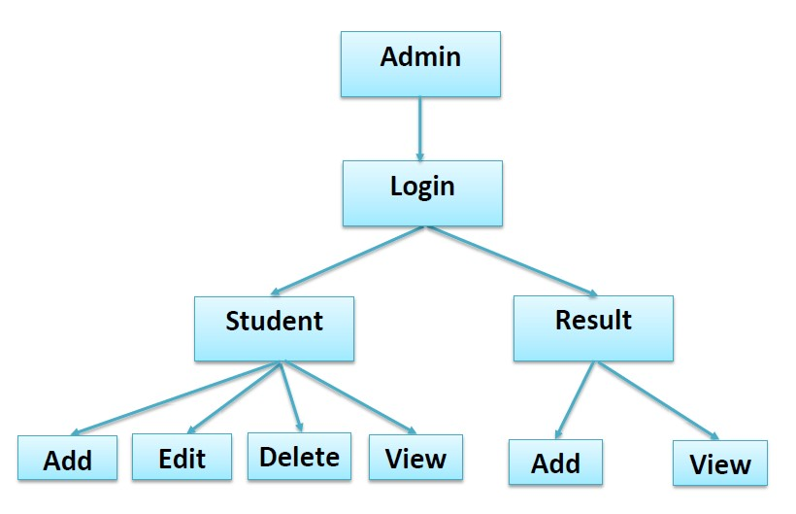
Decision Tree

Slide 11
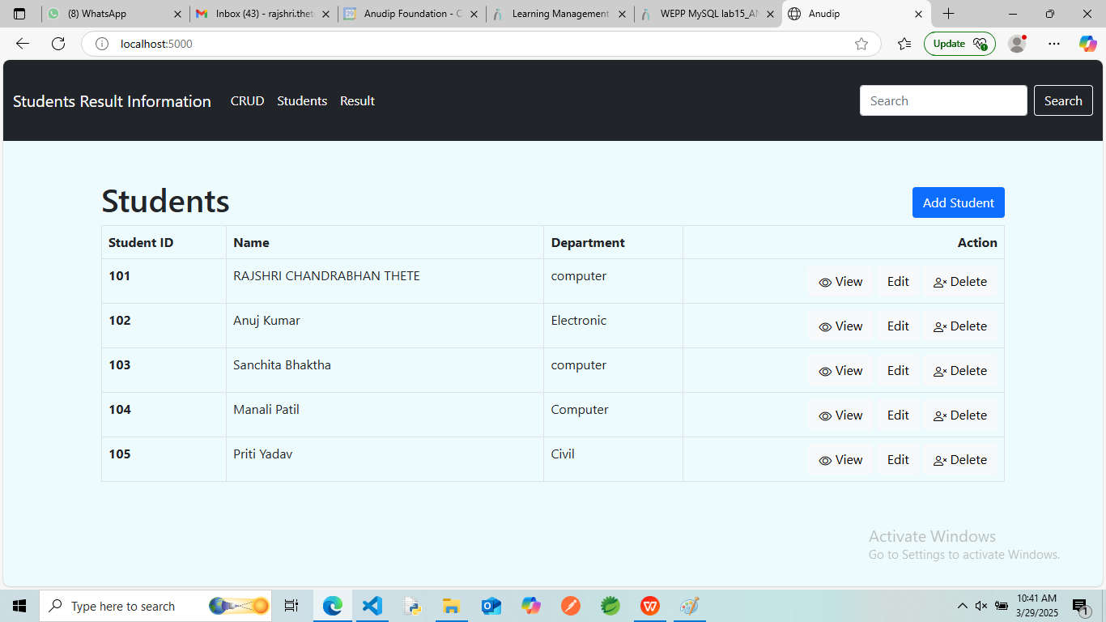
Home

Slide 12
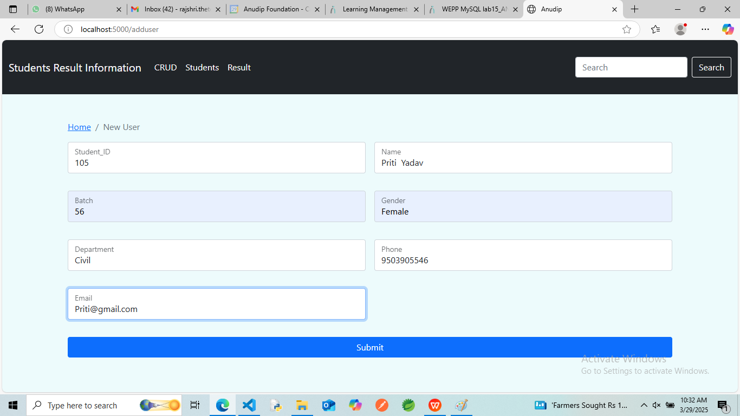
Add Student

Slide 13
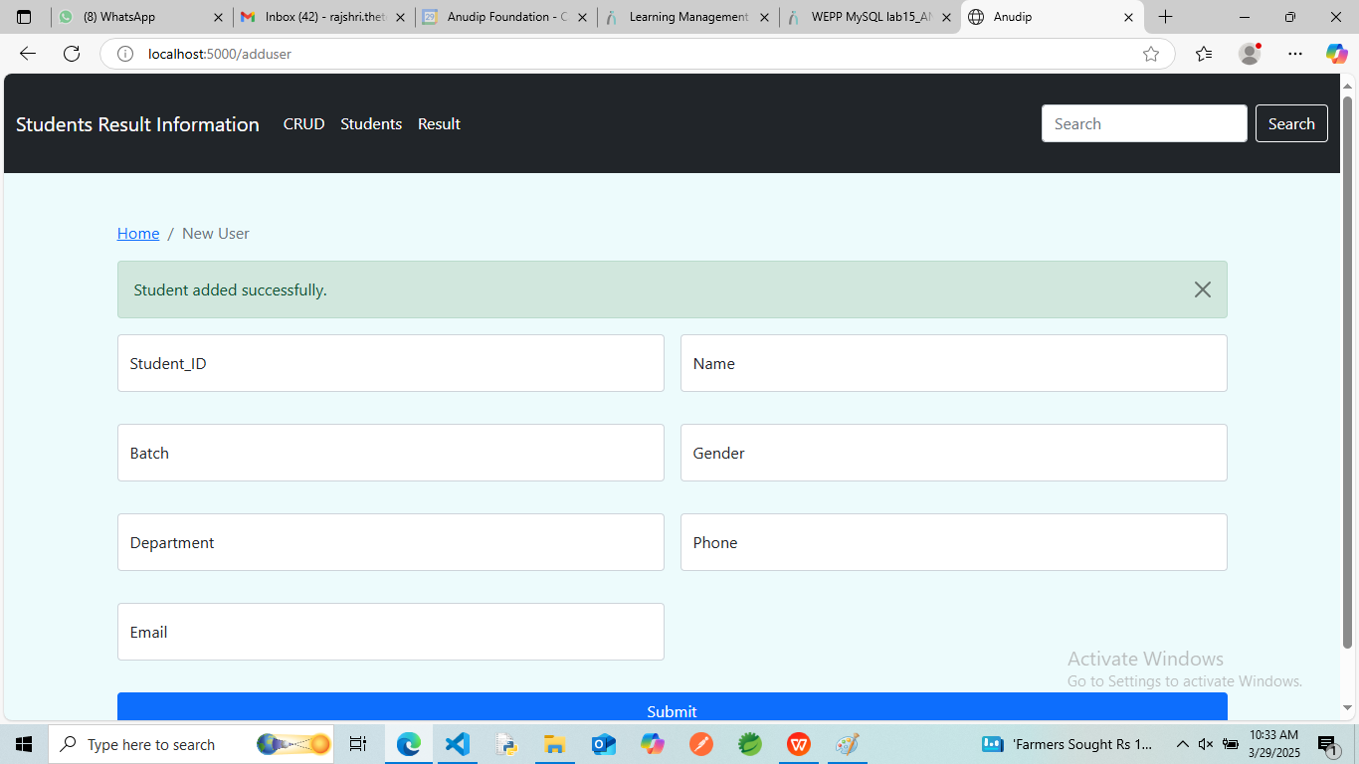

Slide 14
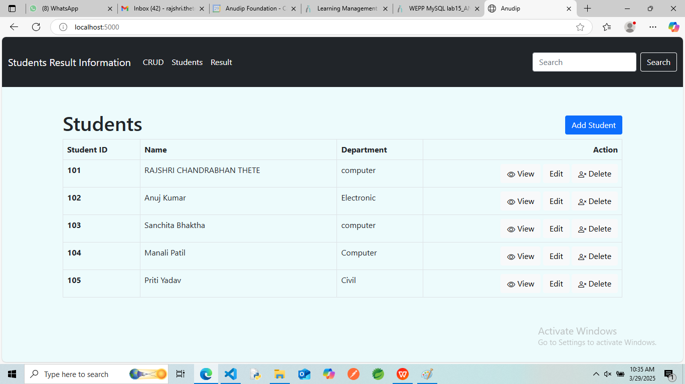

Slide 15
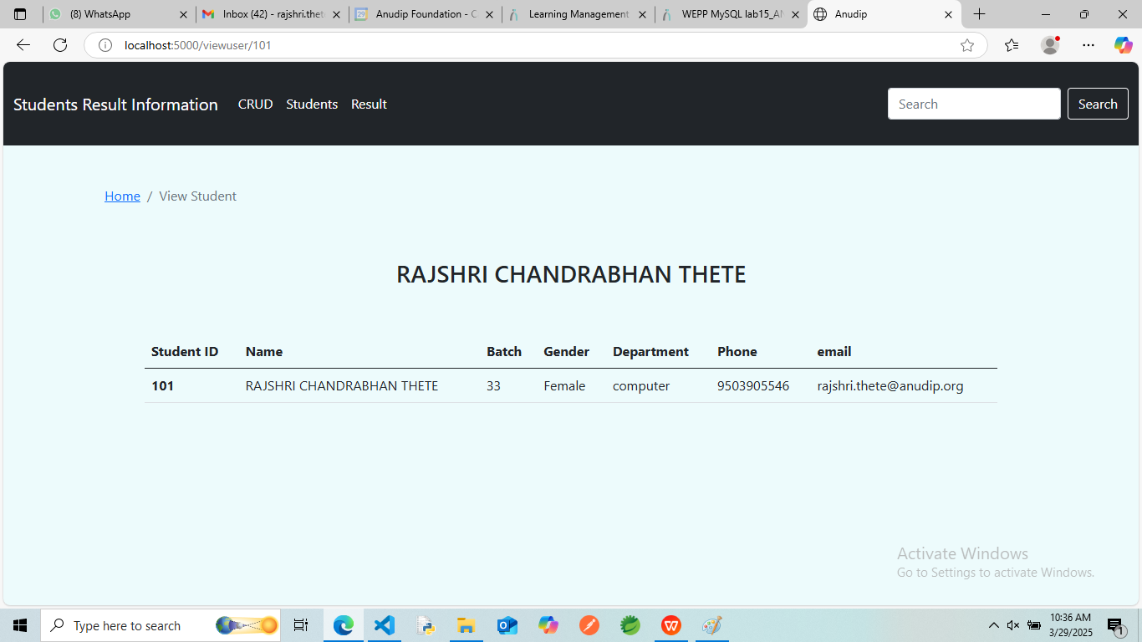
View Student

Slide 16
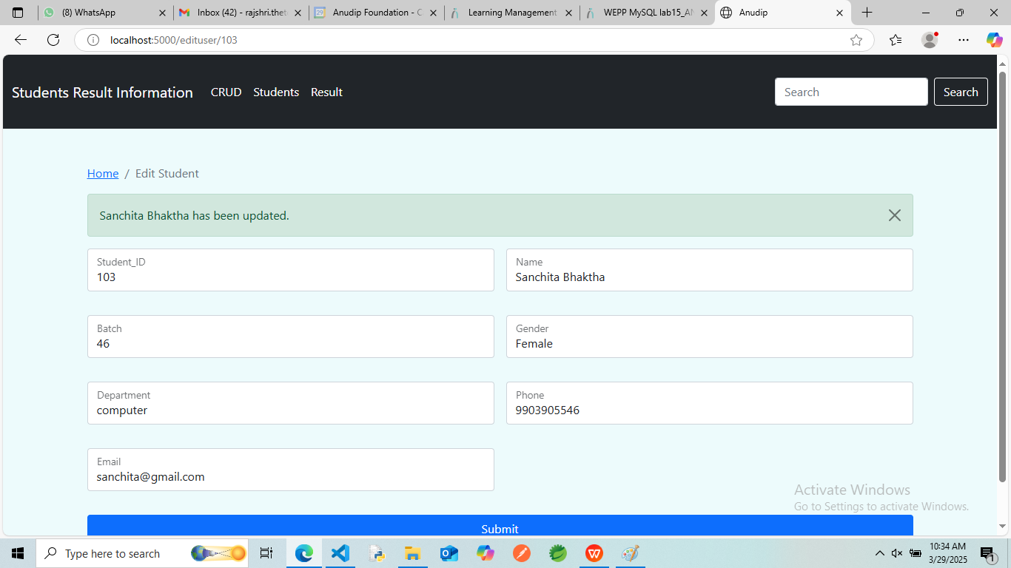
Edit Student

Slide 17
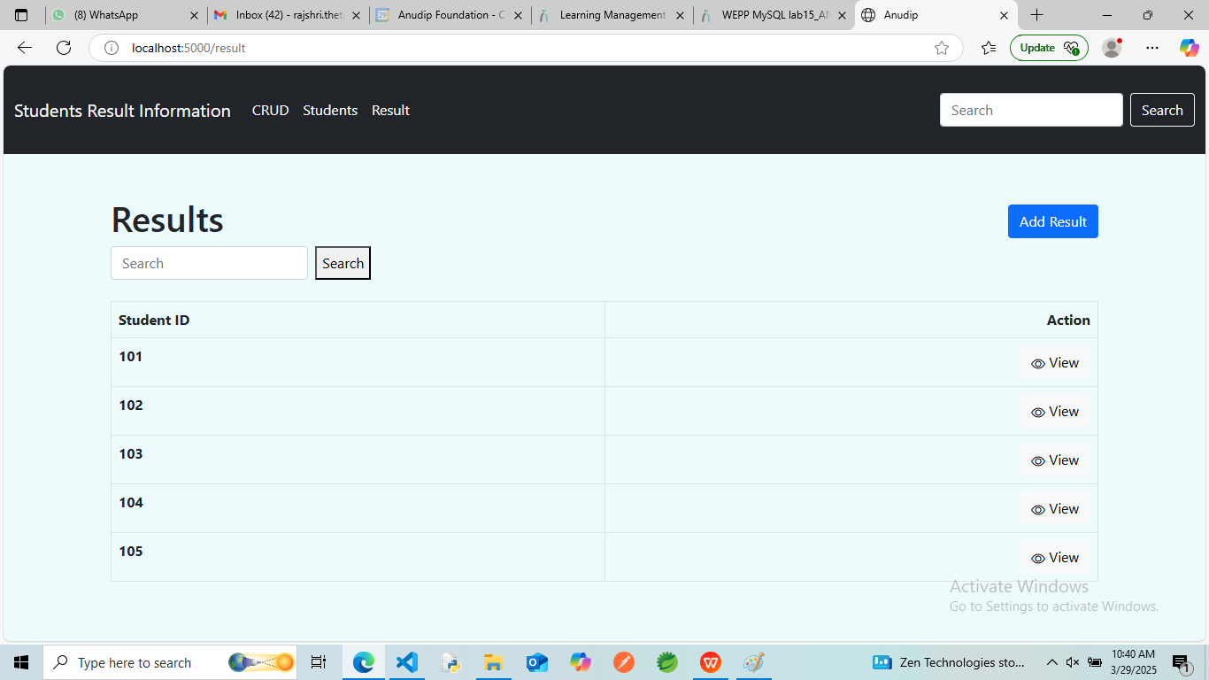
Result

Slide 18
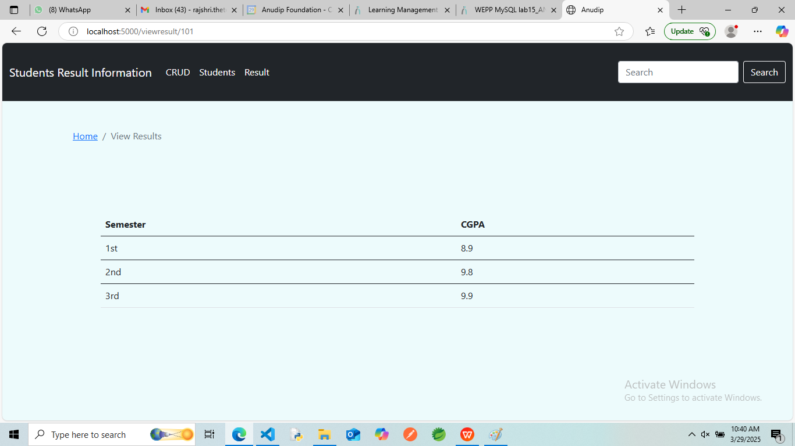
View Results

Slide 19
Conclusion
Student Result management systems make faculty jobs more accessible by giving them an easy place to find and sort information. This system allows teachers and student managers to follow with their student engagement.

Slide 20
Thank You

